Slide 1


Bryan Nice and Dwight Barry
Presents
Exploratory Data Analysis
and the
ADVENTURE IN
DATA PLAYLAND

Slide 2


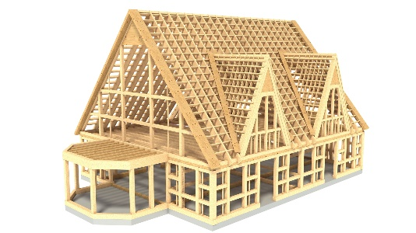


Lesson Overview
Fundamentals
Framework
Discovery
Story sharing

Slide 3

Fundamentals
“Finding patterns is easy in any kind of data-rich environment; that’s what mediocre gamblers do. The key is in determining whether the patterns represent signal or noise”
- Nate Silver

Slide 4

The Big Picture: What is this all about?
Exploratory Data Analysis
Model Development
Monitor, Measure, Recalibrate
Dataset Features
Signal and noise
Missing values
Outliers
Discovery
Inferences
Assumptions
Hypothesis forming
Share the Story
Summarize
Identify next steps
Methods used

Slide 5
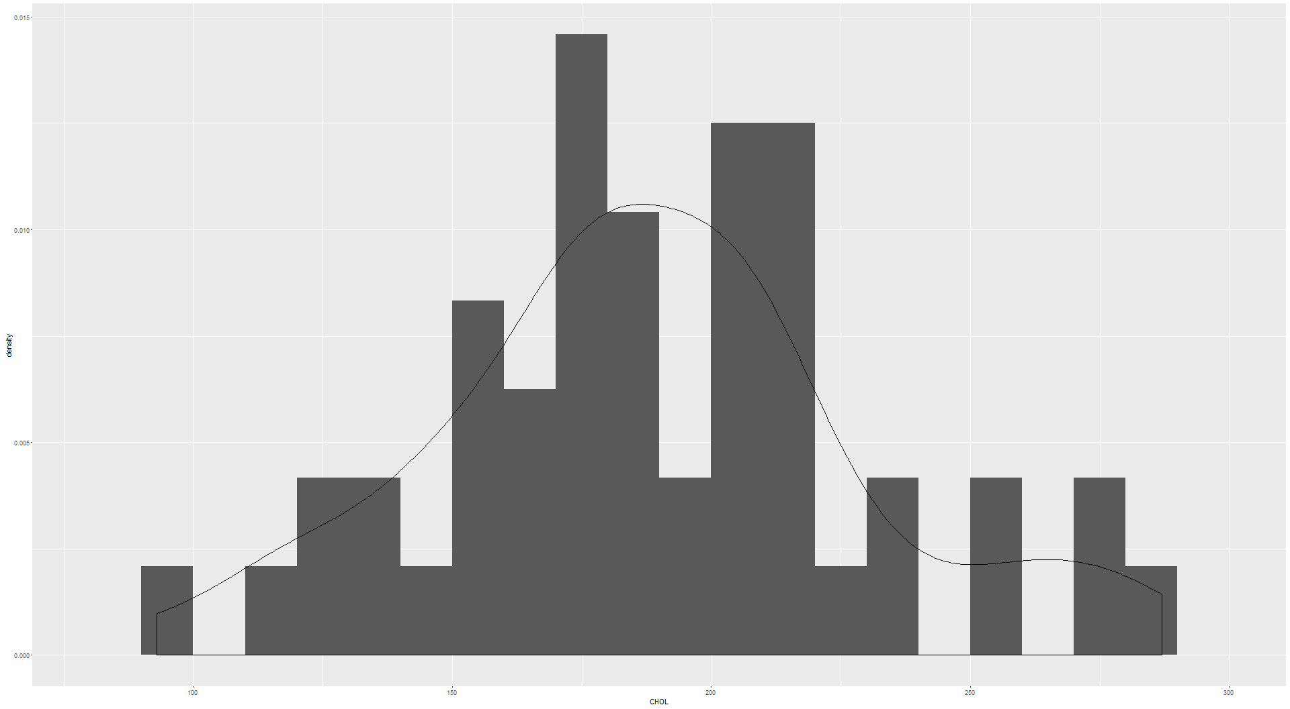
Dataset Features
Frequencies
What is the occurrence of values?
What is the range of values?
What are bucket ranges that best group these values?
How does the bucketing of ranges affect the distribution?
Ranges
Distributions

Slide 6
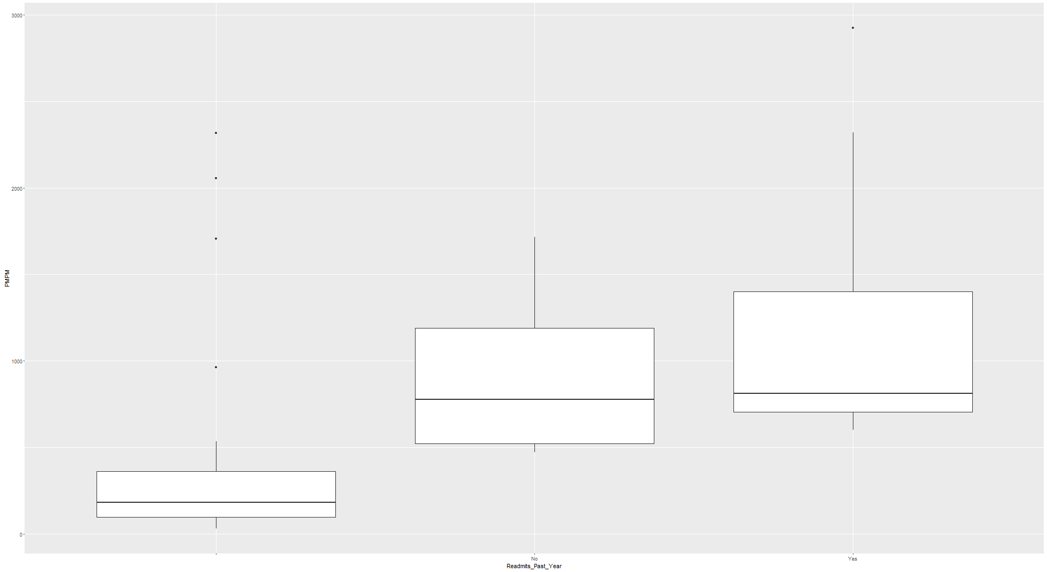
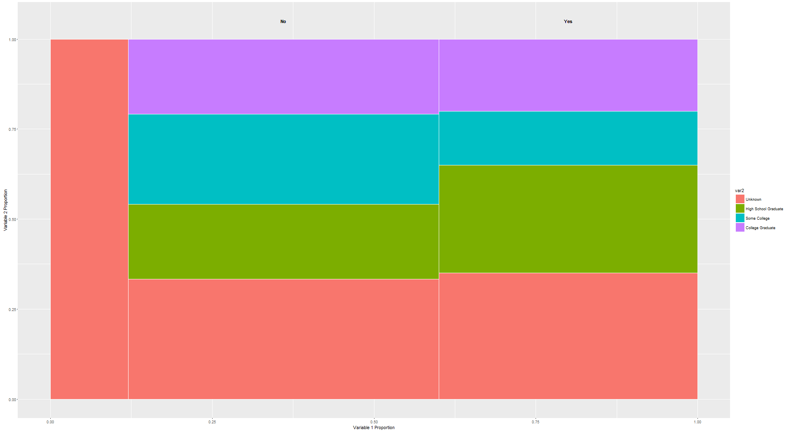
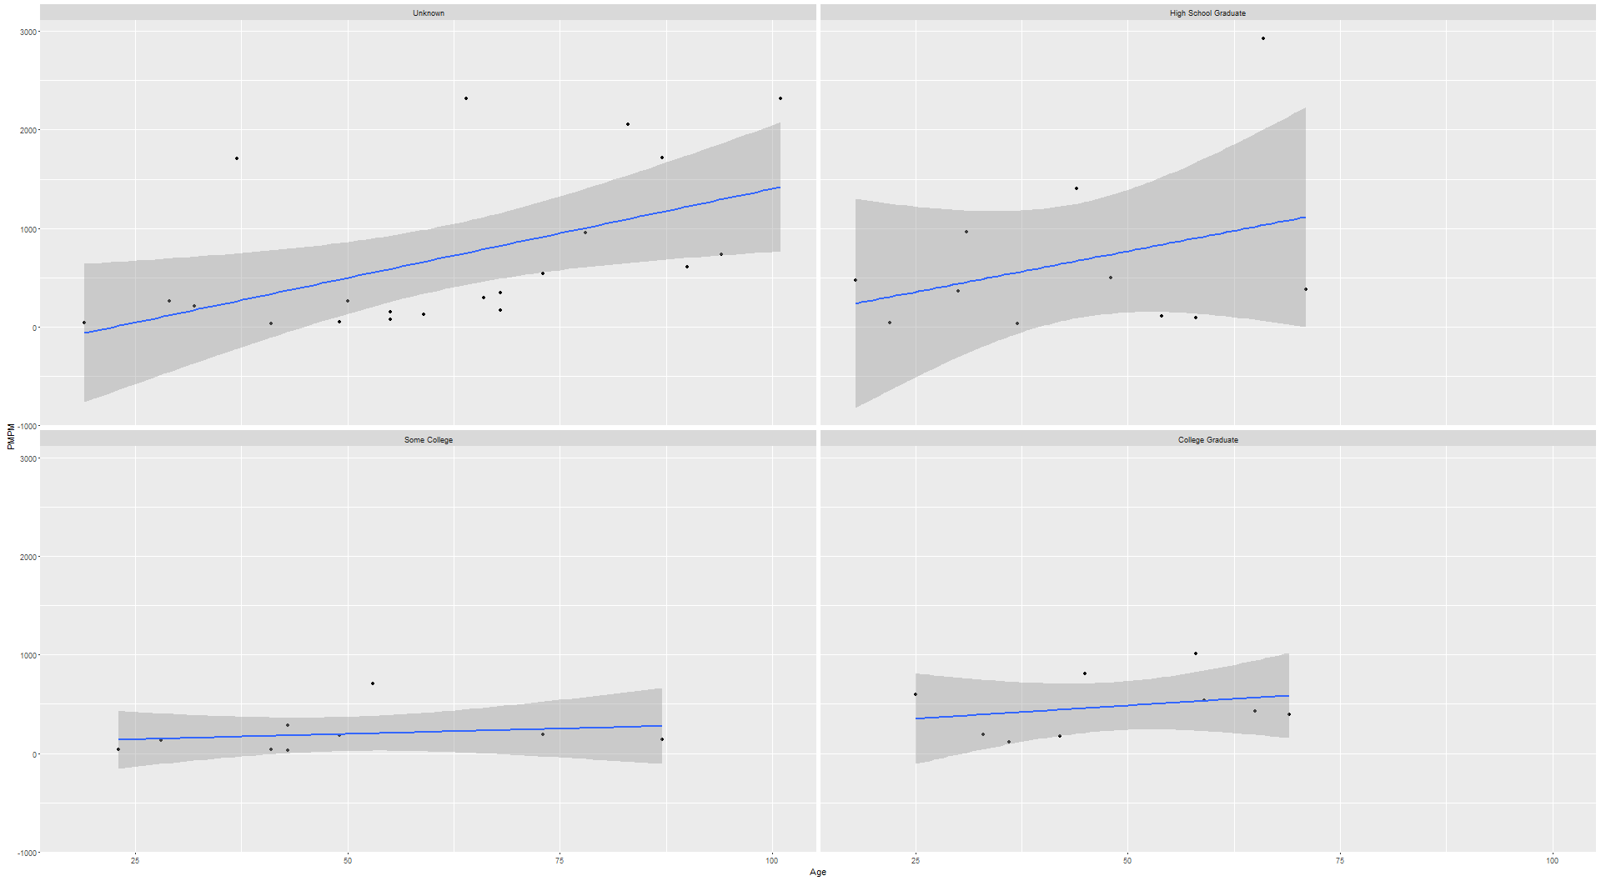
Dataset Features
Outliers
What values skew the distribution? (outliers)
Can the outliers be pruned from the data?
Are there missing values that cause skewness in the distribution?
Are dummy values required to balance the distribution?
Are there relationships between factors?
Missingness
Relationships

Slide 7
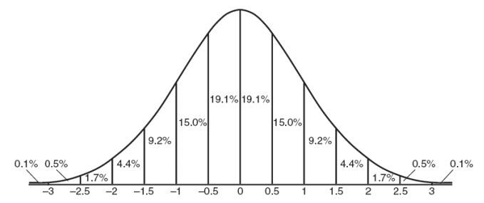
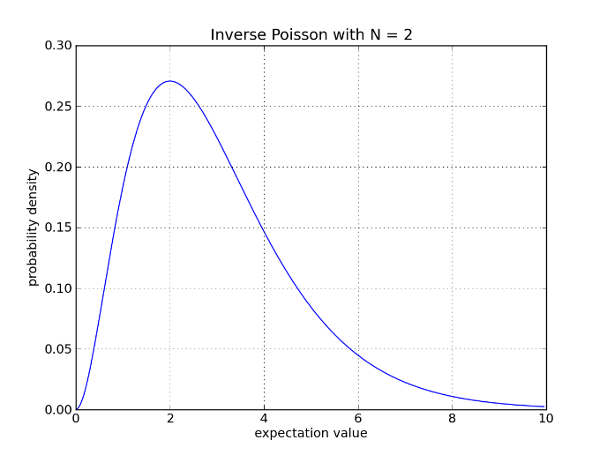
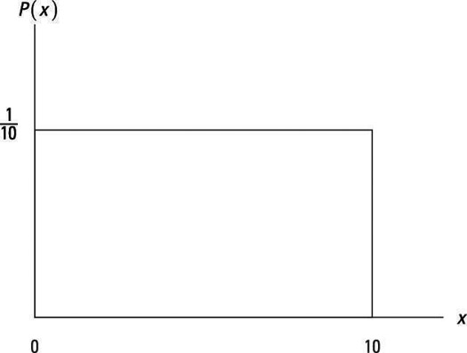
Dataset Features
Summary Statistics
What is the most likely value to occur?
What is the range of possibilities?
What assumptions are made about the data?
What process was used to generate these statistics?

Slide 8

Discovery
Inferences
It’s a process of realization
Inferential integrity with impartiality
Use the evidence to drive the inference
Ways to begin….
The data suggests ________ which led me to think….
It seems __________ will happen because….
When I observed the data it made me realize ________

Slide 9

Discovery
Assumptions
All data is a sample of events in the observable world
All estimates is an approximation of a population
When dummy values are used to replace missing values
Pruning outliers to fit the data in a distribution

Slide 10
Discovery
Hypothesis
Problem framing
Understand the fundamental question
Verify if it is the right question
“Begin challenging your own assumptions. Your assumptions are your windows on the world. Scrub them off every once in awhile, or the light won’t come in.”
- Alan Alda
What do you know?
How do you know that?
Hypothesis + Evidence
+ Reasoning
= Story
Why does your evidence support
your hypothesis?

Slide 11
Share the Story
Key Items:
Summarize
Give recommended decision
Important results
Important Dataset features
Leave details for later on
Reproducible research
Data set features
Methods used
Assumptions
Tool info

Slide 12

Framework
“Today, it’s all about storytelling and infographics, and visuals are a key part of that. All researchers want to connect the reader with the data, and that’s what data visualizations and storytelling can do.”
- Derrak Richard

Slide 13

Share the Story
Exploratory Data Analysis
Model Development
Monitor, Measure, Recalibrate
Dataset Features
Signal and noise
Missing values
Outliers
Discovery
Inferences
Assumptions
Hypothesis forming
Share the story
Summarize
Identify next steps
Methods used

Slide 14
